Slide 1

Exam AZ-300/303: Microsoft Azure Architect Technologies Crash Course
Tim Warner

Slide 2


Tim Warner
Based in Nashville, TN, US
MCT, MVP
Twitter: @TechTrainerTim
Badge: timw.info/azarchcert

Slide 3

Tim Warner
timw.info/ms300
O’Reilly Online Learning

Slide 4
Course Materials
timw.info/az300

Slide 5
Session 1 of 2 Learning Goals
Introduction
Deploy and configure Azure infrastructure
Storage
Network
Compute
Monitoring
Identity

Slide 6
Session 2 of 2 Learning Goals
Azure migration
Workload security
App deployment
App Service
Containers
Serverless
AZ-300/303 exam strategy

Slide 7
Setting Expectations
Azure Architect is an expert-level certification
You should already know how to deploy and configure Azure resources
This is a "crash course"
Please plan to review these materials more than once
Five-minute break at midpoint
Please ask/answer questions and provide feedback in the Q/A panel, not the group chat

Slide 8
2020 Exam Update Information
Microsoft Worldwide Learning (WWL) revisits the Azure role-based certs yearly
Relevant blog post: timw.info/az2020
Changes:
AZ-300 replaced with AZ-303
AZ-301 replaced with AZ-304
AZ-304 beta will be available around June 29, 2020
AZ-301 retires around September 30, 2020

Slide 9
2020 Exam Update Information
You can earn your badge by combining the old and new exam versions:
AZ-300 and AZ-304
AZ-301 and AZ-303
The certification is the same, and has a 2-year expiry
If you’re already prepping for AZ-300, stay the course!
Beta exams sometimes takes a long time
Cert prep vendors need time to develop new materials

Slide 10
Tim's Certification Study Pyramid
Interdependence
Content knowledge
Practical application
Test-taking skills

Slide 11
Module 1: Deploy and Configure Azure Infrastructure

Slide 12
Storage Account Replication
1
3
3
2
LRS
ZRS

Slide 13
Storage Account Replication
1
3
1
3
2
2
GRS – RA/GRS

Slide 14
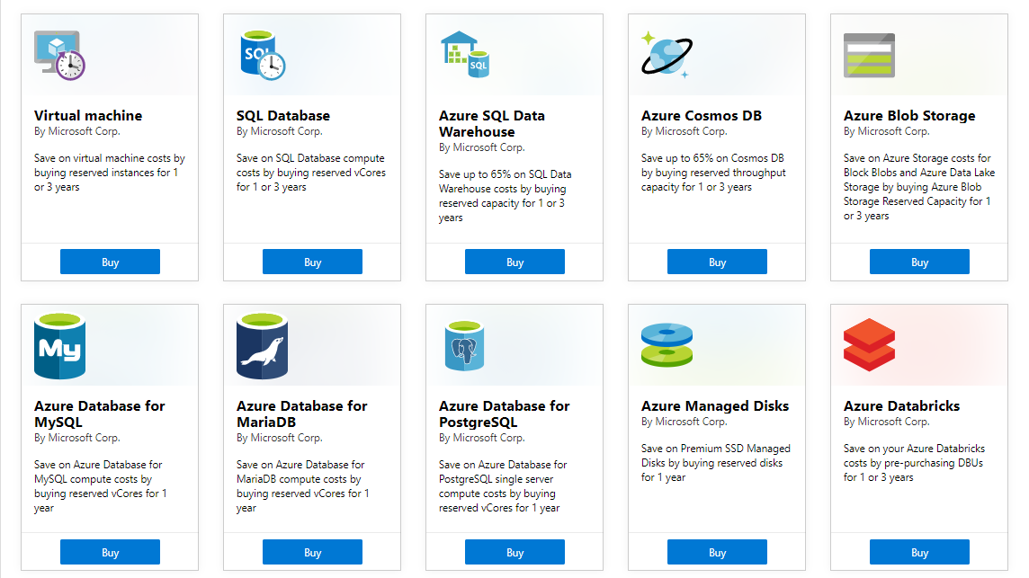
Azure Reservations

Slide 15
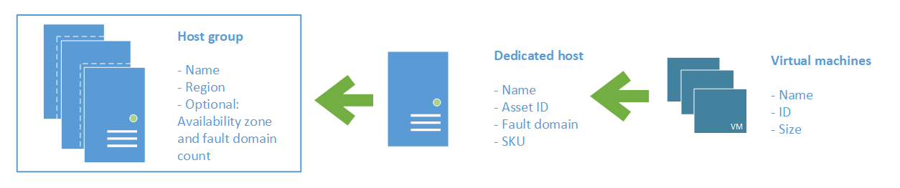
Azure VM Dedicated Host

Slide 16

Availability Set

Slide 17

Availability Zone

Slide 18

Hybrid Networking

Slide 19

VNet Peering

Slide 20

Network Virtual Appliance

Slide 21

Load Balancing

Slide 22

Azure Load Balancer

Slide 23

Application Gateway

Slide 24

Traffic Manager

Slide 25

Front Door Service

Slide 26

Hybrid Identity

Slide 27

Federated Identity

Slide 28
Module 2 Implement Azure Workloads and Security

Slide 29
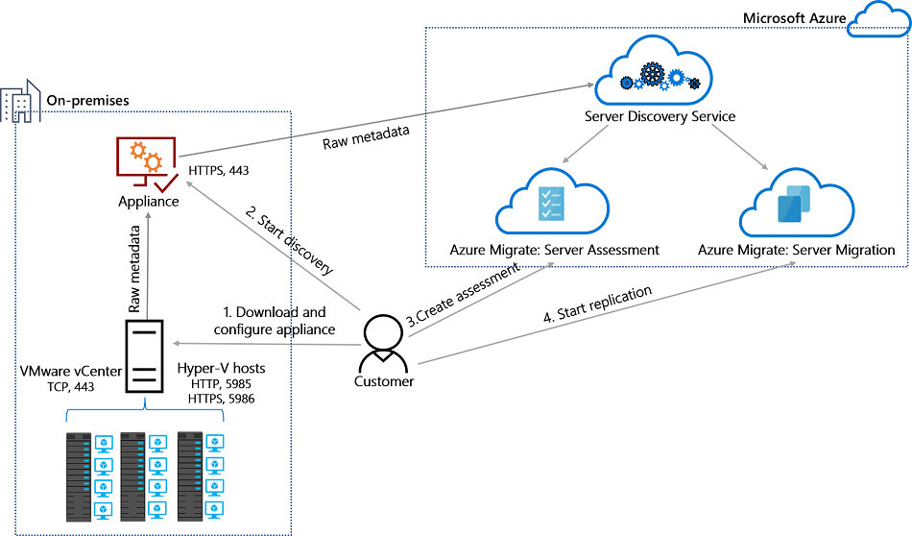
Azure Migrate

Slide 30
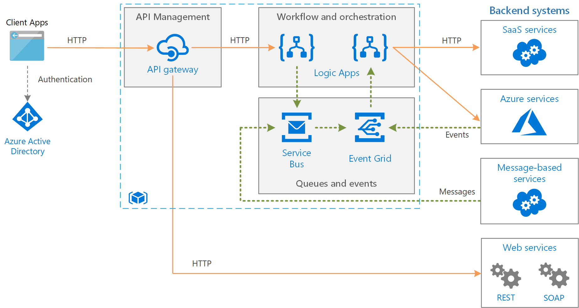
Message-Based Architecture

Slide 31

Azure Management Scopes
/ Tenant Root

Slide 32
Module 3: Create and Deploy Apps in Azure

Slide 33


Docker Container Lifecycle
https://timw.info/3635f

Slide 34
Module 4: Implement Authentication and Secure Data in Azure

Slide 35
Hybrid Identity

Slide 36
Federated Identity

Slide 37

Passthrough Authentication

Slide 38

Seamless Single Sign-on

Slide 39

Always Encrypted

Slide 40
Module 5: Develop for the Cloud and for Azure Storage

Slide 41

VM Scale Sets

Slide 42
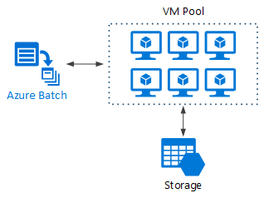
Azure Batch

Slide 43
Module 6: Exam AZ-300 Exam Strategy

Slide 44
Module 6 Learning Objectives
Grasp the content
Acquire the hands-on skills
Master computer-based testing
Comprehend what to expect before, during, and after the exam

Slide 45
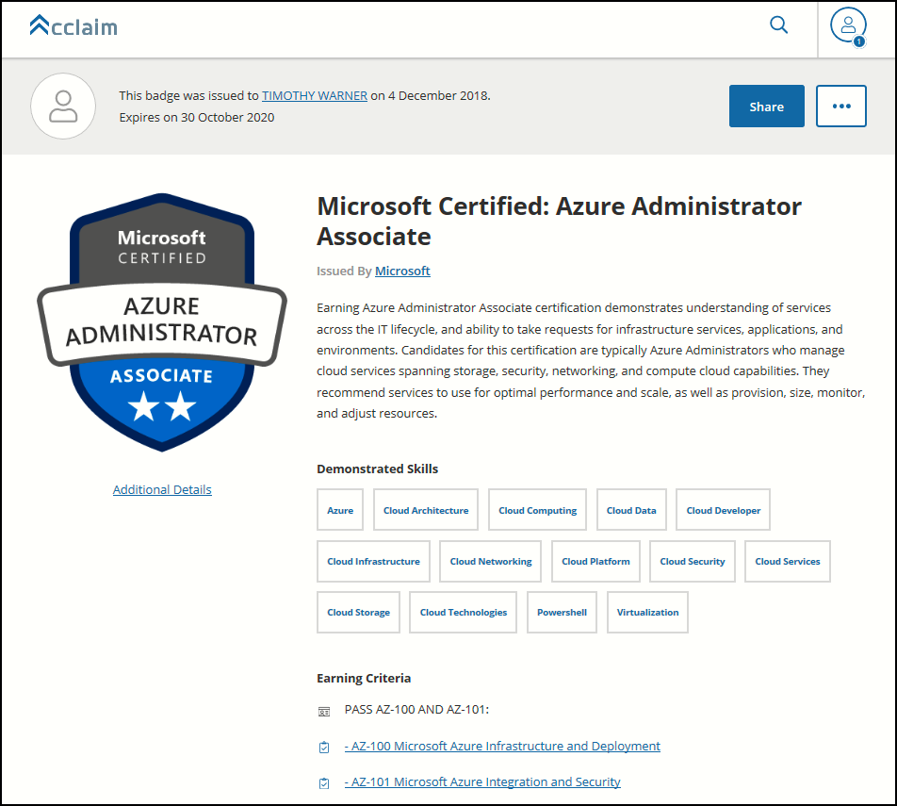
Digital Credentials by Credly/Acclaim

Slide 46
Exam AZ-300 Item Types

Slide 47

Multiple Choice

Slide 48
Repeated Scenario
You need to move an Azure VM to another hardware host.
Solution: You redeploy the VM.
Does this solution meet the goal?
Yes
No

Slide 49

Select and Place

Slide 50

Build List and Reorder

Slide 51

Active Screen/Fill in the Blank

Slide 52

Case Study

Slide 53






Performance-Based Lab

Slide 54
Microsoft Online Testing

Slide 55

Microsoft Online Testing Process

Slide 56

Microsoft Online Testing Process

Slide 57

Microsoft Online Testing Process

Slide 58

Microsoft Online Testing Process

Slide 59

Microsoft Online Testing Process

Slide 60

Microsoft Online Testing Process

Slide 61

Microsoft Online Testing Process

Slide 62
AZ-300 Exam Strategy/Tips
Focus your skills accordingly:
60 percent Azure portal
20 percent Azure PowerShell
10 percent Azure CLI
10 percent KQL
Expect performance-based labs, and be surprised if you don't see 'em

Slide 63
Thank you!
Course materials: timw.info/az300
Twitter: @TechTrainerTim
Work: timw.info/ps
Web: TechTrainerTim.com

